Slide 1
Empowered to Collaborate, or Challenged by Imbalanced Power: The Impact of Archives Existing in Libraries
Ashley Todd-Diaz
2018 SAA Research Forum
Washington D.C.
August 14, 2018
Notes:
Happy about what is emerging; want to share it with you
Within the academic environment, ~90% of archives exist within libraries in a parent-child relationship
Potentially problematic when we consider libraries and archives have had distinct education programs, values, identities, professional organizations, etc.
Lines are blurring as we enter into the digital environment, increasing talk of convergence
Very little empirical research into this area

Slide 2
Background
Libraries and archives have existed separately.
Many archives in the US exist organizationally within libraries.
Within the last decade, research on the convergence between libraries and archives has increased.
Notes:
- Education, values, identity
- Special joint issues of Library Quatrerly, Archival Science, and Museum Management and Curatorship between 2008-2010
- Robert S. Martin (2007), former Director of IMLS, defined LAMs as “social agencies that are all collectively responsible for preserving the shared knowledge of humankind, making it available for everyone to use, and transmitting it to future generations” (p. 87).
- In the digital world, silos or structures are becoming less relevant (Cannon, 2012)
- Sense that users will prefer seamless resources (Kirchhoff, Schweibenz, & Sielglerschmidt, 2008)
- Duff, Carter, Cherry, MacNeil, and Howarth (2013) LAM professionals say their primary motivation to collaborate/converge is to assist users
- Waibel and Erway (2009)’s collaboration continuum model – convergence is the end point of long term, active initiatives that begins with contact and progresses through co-operation, co-ordination, and collaboration
- ARL library data
- 91% (113 of 124) of archives report to the University Library Dean/Director/Chief Librarian
Bastian et al. (2015)
Among ARL members, 44% of archives existing within libraries are located in units that do not have the word “archives” in the title
Only 52.6% of A*CENSUS (2006) respondents identified as an archivist or manuscripts curator

Slide 3
Research focuses
Corporate identity of an archives within a library
Tensions surrounding parent-child relationships
The impact of corporate identity and placement of archives within libraries on the user experience
Notes:
How do we reconcile this situation with the fact that a majority of archival programs in the United States function through a parent-child relationship with library organizations?

Slide 4
Methodology
Collective case study (5 institutions) that includes three investigations:
Document analysis
Semi-structured interviews with administrators
Intercept survey with users
Comparison across data sources, as well as within organizations
Notes:
Multi-method study
Happy to talk more about the specifics

Slide 5
Emergent Insights
Collaboration and/or Challenges

Slide 6
Collaboration
“An army of three is not very strong. We have 15 faculty; so a library of 15 is stronger than an army of three” (Dean, Inst. 4).
“I think there are a lot of natural partnerships that it just makes it much easier for them to be in the same big unit” (AUL, Inst. 3).
“I think there’s a bit more of a sense of camaraderie and being a part of larger library issues because we are in the same building” (Head of SpecColl, Inst. 1).

Slide 7
So close, but so far away
“I guess a lot of what we do is separate from the library and it’s downstairs” (Archivist_2, Inst. 2).
“I’m not an outsider, but I feel like I’m watching [the library] from a distance” (Head of SpecColl, Inst. 4).

Slide 8
Perceived impact
“I made a really serious mistake once…we decided to make [a new archivist] position a librarian. I sent out a message to the staff and said we made this decision because this was somebody who is going to be operating with an impact across the whole library system, and so we felt it was appropriate for this person to be a librarian” (AUL, Inst. 1).

Slide 9
Are we on the same team?
“There is still this sense of privilege about [special collections]. It is very different work from what most people do; we say no a lot” (Head of SpecColl, Inst. 1).
“[Staff meetings let us] hear what’s going on in the library because we’re closed off to a lot of that, and we’re on a different email thread from them” (Archivist_2, Int. 2).
“When we consolidated academic support into our division, it made sense to physically separate [SpecColl] from the library because it was a different population using the archives” (Dean, Inst. 4).

Slide 10
Implications
Behavioral Theory of the Firm (Cyert and March, 1963/2010)
Proximity does not guarantee collaboration or alignment of goals.
Organizational culture cultivates the potential for collaboration or conflict.
Users are focused on convenience and how an archives relates to them.
64% of users note the need for the materials is more important than location.
Cyert, R., & March, J. G. (2010). A behavioral theory of the firm. New Jersey: Prentice Hall, Inc. (Original work published 1963.)
Notes:
Want to leave you with a thought about the larger implications about this fairly narrow investigation
Underlying theory that drives this is Cyert and March’s Behavioral Theory of the Firm
An organization is made up of coalitions with differing goals and priorities
- Internal negotiations – placement of archives, budget negotiations, job classification
Where do users factor into this discussion?

Slide 11
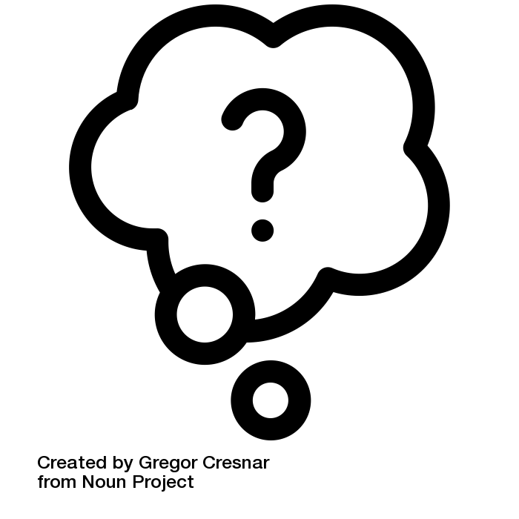
Thank you!
Ashley Todd-Diaz
Head of Special Collections and University Archives
Towson University
atodddiaz@towson.edu

